Slide 1
Mining Software Repositories
John Businge
Henrique Rocha

Slide 2
References

Slide 3
More References

Slide 4
Acknowledgement
Ahmed E. Hassan
Queen’s University
www.cs.queensu.ca/~ahmed
ahmed@cs.queensu.ca
Tao Xie
North Carolina State University
www.csc.ncsu.edu/faculty/xie
xie@csc.ncsu.edu
Bram Adams
Polytechnique Montréal, Canada
http://mcis.polymtl.ca/index.html
lab.mcis@gmail.com
With updates by John Businge from University of Antwerp, Belgium

Slide 5
Lecture Goals
Learn about:
Classic and notable research and researchers in mining SE data
Data mining and data processing techniques and how to apply them to SE data
Risks in using SE data due to e.g., noise
After the lecture, you should be able to:
Retrieve SE data
Prepare SE data for mining
Mine interesting information from SE data

Slide 6
Why mine SE data?
SE data can be used to:
Gain empirically-based understanding of software development
Predict, plan, and understand various aspects of a project
Support future development and project management activities

Slide 7
How is SE Data generated?

Slide 8
What is MSR?
Transforming static record keeping SE into active data
Making SE data actionable by uncovering patterns and trends
Git
Bugzilla
Mailing
Lists
Code Repos
Execution Traces

Slide 9
MSR researchers analyze and cross-link repositories
New bug report
Estimate fix effort
Suggest experts and fix!

Slide 10
Study Outline
Part I: What can we learn from SE data?
A sample of notable findings for different SE data types
Part II: How can we mine SE data?
Understand the structure of SE data

Slide 11
MSR studies – Bugs – Part I
Using imports to predict Bugs

Slide 12
MSR studies - Bugs
Do not program on Friday ;-)

Slide 13
MSR studies – Sentiment Analysis
Anger vs. Joy
How they stack up?
PHP, Object-C, and C# are net positive
Java, Shell, and C are fairly even while VimL is just bad news.
[Doll and Grigorik, 2012]

Slide 14
MSR studies – Sentiment Analysis
http://www.commitlogsfromlastnight.com/

Slide 15
MSR studies – Programming languages
Programming language relations
A Ruby programmers is very likely to know Javascript, while a Perl programmer is not
Java is a popular programming language but stands primarily alone
https://github.com/mjwillson/ProgLangVisualise

Slide 16
MSR studies – Changes by programmers
Programming language relations
After the programmer has made some changes to the source (above), ROSE suggests locations (below) where, in similar transactions in the past, further changes were made
[Zimmermann, 2005]
Mining Version Histories to Guide Software Changes

Slide 17
How can we mine SE Data – Part II
Repositories of Repositories
April 2019
28 Millinon repositories
10 Million Users
January 2020:
100 Millinon repositories
40 Million Users
April 2019
28K projects
January 2020:
430K repositories
3.7 Million Users

Slide 18

How can we mine SE Data

Slide 19
How can we mine SE Data
Easiest to obtain local copy (distributed version control!), and has distinction between authors and committers, but … branches can be pain to analyze

Slide 20
How can we mine SE Data
Access to thousands of Git-based projects via GitHub

Slide 21
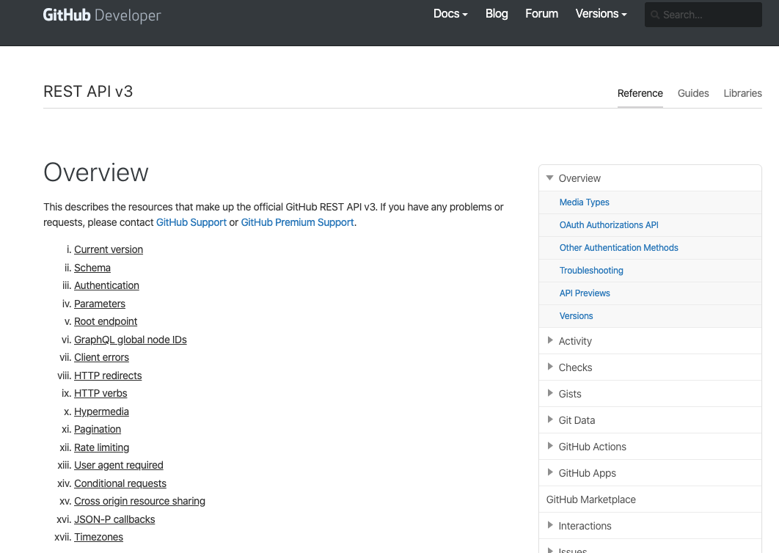
How can we mine GitHub Data
How can we obtain GitHub data?

Slide 22
How can we mine GitHub Data
There are rate-limit issues!
You are only allowed only a limited number of GitHub requests per hour
How can we obtain GitHub data?

Slide 23
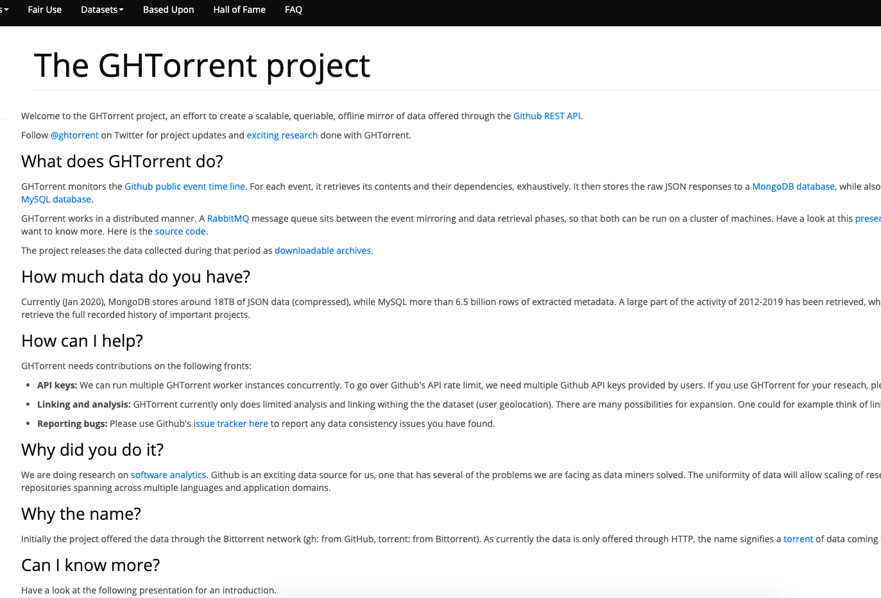
How can we mine GitHub Data
There are rate-limit issues!
Use GHTorrent Project
It continuously monitors GitHub event time line
How can we obtain GitHub data?

Slide 24
How can we mine GitHub Data
There are rate-limit issues!
GitHub allows one to use authentication where u get a token (5000 requests/hr)
How can we obtain GitHub data?

